Slide 1
Introduction to Java
Class 7:
Single and Multidimensional Array

Slide 2
Introduction
A single array variable can reference a large collection of data.

Slide 3
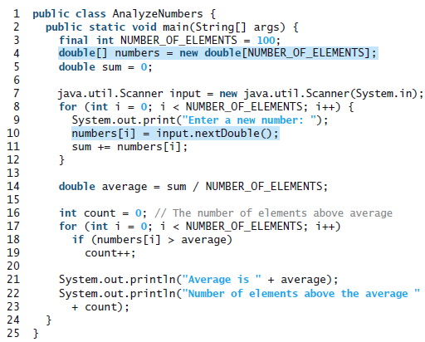
Introduction

Slide 4
Introduction
The program creates an array of 100 elements in line 4, stores numbers into the array in line
10, adds each number to sum in line 11, and obtains the average in line 14. It then compares
each number in the array with the average to count the number of values above the average
(lines 16–19).

Slide 5
Array Basics
Once an array is created, its size is fixed. An array reference variable is used to access
the elements in an array using an index.

Slide 6
Declaring Array Variables
elementType[] arrayRefVar;
double[] myList;

Slide 7
Creating Arrays
arrayRefVar = new elementType[arraySize];
This statement does two things:
1. Creates an array using new elementType[array-Size];
2. Assigns the reference of the newly created array to the variable arrayRefVar.

Slide 8
Creating Arrays
If you want to combine those:
elementType[] arrayRefVar = new elementType[arraySize];
or
elementType arrayRefVar[] = new elementType[arraySize];
Example:
double[] myList = new double[10];

Slide 9
Creating Arrays
The following code initializes the array:
myList[0] = 5.6;
myList[1] = 4.5;
myList[2] = 3.3;
myList[3] = 13.2;
myList[4] = 4.0;
myList[5] = 34.33;
myList[6] = 34.0;
myList[7] = 45.45;
myList[8] = 99.993;
myList[9] = 11123;

Slide 10
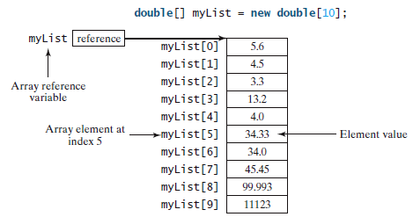
Creating Arrays

Slide 11
Array Initializer
elementType[] arrayRefVar = {value0, value1, ..., valuek};
Example:
double[] myList = {1.9, 2.9, 3.4, 3.5};
Which is the same as:
double[] myList = new double[4];
myList[0] = 1.9;
myList[1] = 2.9;
myList[2] = 3.4;
myList[3] = 3.5;

Slide 12
Processing Arrays
Use for loops to process arrays.
double[] myList = new double[10];
for (int i = 0; i < myList.length; i++)
doSomething();

Slide 13
Processing Arrays
Initialize array with random numbers:
for (int i = 0; i < myList.length; i++) {
myList[i] = Math.random() * 100;
}
Display arrays:
for (int i = 0; i < myList.length; i++) {
System.out.print(myList[i] + " ");
}
Sum elements:
double total = 0;
for (int i = 0; i < myList.length; i++) {
total += myList[i];
}

Slide 14
for-each Loop
for (double u: myList) {
System.out.println(u);
}
You can read the code as “for each element u in myList, do the following.” Note that the variable, u, must be declared as the same type as the elements in myList.

Slide 15
for-each Loop
for (elementType element: arrayRefVar) {
// Process the element
}

Slide 16
Copying Arrays
To copy the contents of one array into another, you have to copy the array’s individualelements into the other array.

Slide 17
Copying Arrays
int[] sourceArray = {2, 3, 1, 5, 10};
int[] targetArray = new int[sourceArray.length];
for (int i = 0; i < sourceArray.length; i++) {
targetArray[i] = sourceArray[i];
}

Slide 18
Copying Array
Array is a class in Java, which means that it has methods that perform certain tasks.

Slide 19
Copying Arrays
Another approach is to use the arraycopy method in the java.lang.System class to copy arrays instead of using a loop. The syntax for arraycopy is:
arraycopy(sourceArray, src_pos, targetArray, tar_pos, length);
The parameters src_pos and tar_pos indicate the starting positions in sourceArray and targetArray, respectively. The number of elements copied from sourceArray to targetArray is indicated by length.
System.arraycopy(sourceArray, 0, targetArray, 0, sourceArray.length);

Slide 20
Passing Arrays to Methods
public static void printArray(int[] array) {
for (int i = 0; i < array.length; i++) {
System.out.print(array[i] + " ");
}
}

Slide 21
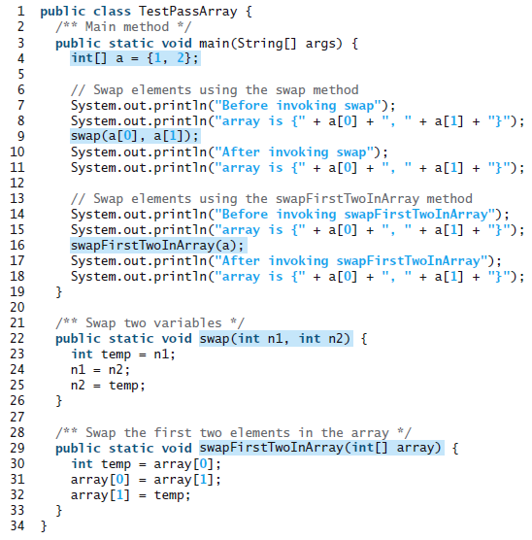
Passing Arrays to Methods

Slide 22
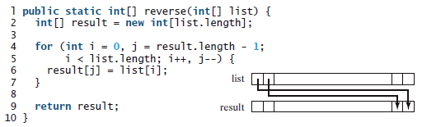

Return an Array

Slide 23
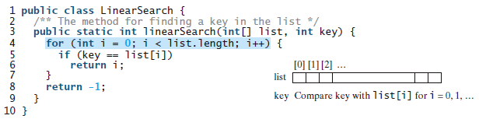
Linear Search in an Array

Slide 24
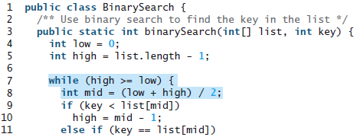
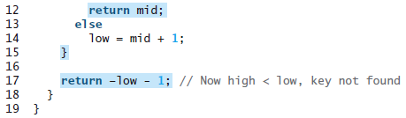
Binary Search in an Array
Elements must be in order!

Slide 25
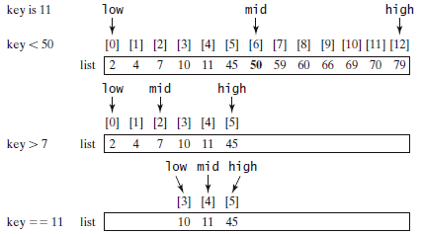
Binary Search in an Array

Slide 26
Sorting Arrays
Selection sort finds the smallest number in the list and swaps it with the first element. It then finds the smallest number remaining and swaps it with the second element, and so on, until only a single number remains.
The insertion-sort algorithm sorts a list
of values by repeatedly inserting a new element into a sorted sublist until the whole list is
sorted.

Slide 27
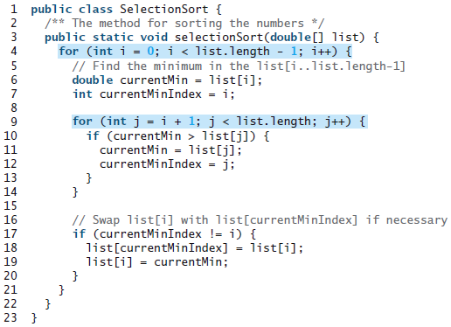
Sorting Arrays

Slide 28
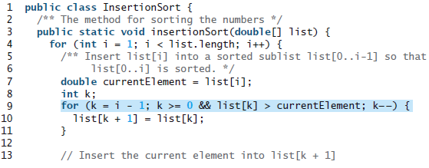

Sorting Arrays

Slide 29
The Array Class
The java.util.Arrays class contains useful methods for common array operations
such as sorting and searching. Some important methods: sort, binarySearch, equals, fill, toString.

Slide 30
Two Dimensional Array Basics
elementType[][] arrayRefVar;
or
elementType arrayRefVar[][];
// Allowed, but not preferred

Slide 31
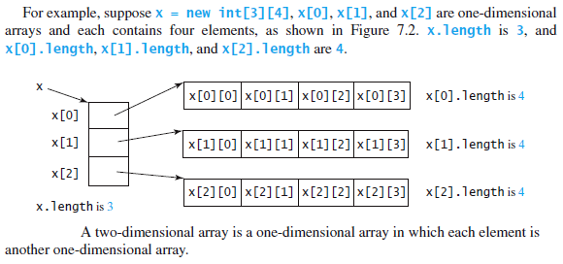
Counting Elements

Slide 32
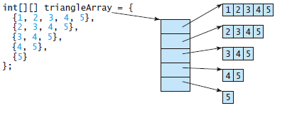
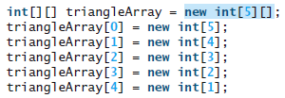
Raged Arrays

Slide 33
Processing Two Dimensional Arrays
How would you process two dimensional arrays?

Slide 34
Processing Two Dimensional Arrays
Nested for loops are often used to process a two-dimensional array.

Slide 35
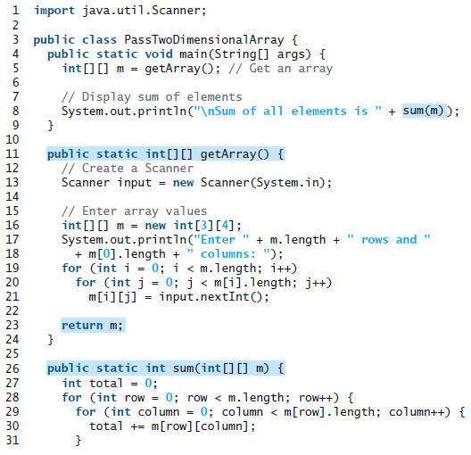


Slide 36
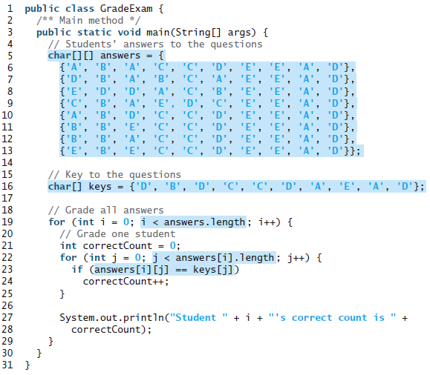

Slide 37
Multidimensional Arrays
A two-dimensional array consists of an array of one-dimensional arrays and a hreedimensional array consists of an array of two-dimensional arrays.

Slide 38
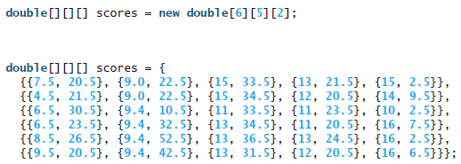
Multidimensional Arrays

